Slide 1
Pirate Dash
By Nadia Nadeem

Slide 2
Task Aims
To create a 2D Boat Race based on a specific theme specified in the assignment brief. The theme chosen was pirate based.
The game needed to include:
Continuous scrolling background.
Boat can move forwards, backwards and rotate left and right.
UI with player lives, health, score and a timer.
Boat animations.
Playable with a third-party controller or keyboard.
Two randomly timed obstacles with penalties.
Two unique rewards.

Slide 3
Controls
W, A, S, D keys.
An Xbox One controller can be used. The left joystick is used to move the boat up and down and the right joystick is used to rotate left and right.

Slide 4
How To Play
The player must dodge obstacles and try to get coins to increase the score. The longer the timer goes on the more of a bonus the player gets to the score.
Obstacles take away health from the player.
Once the player’s health hits 0 a life is taken away from the player.
When the player is out of lives the game ends and the score bonus is added.

Slide 5
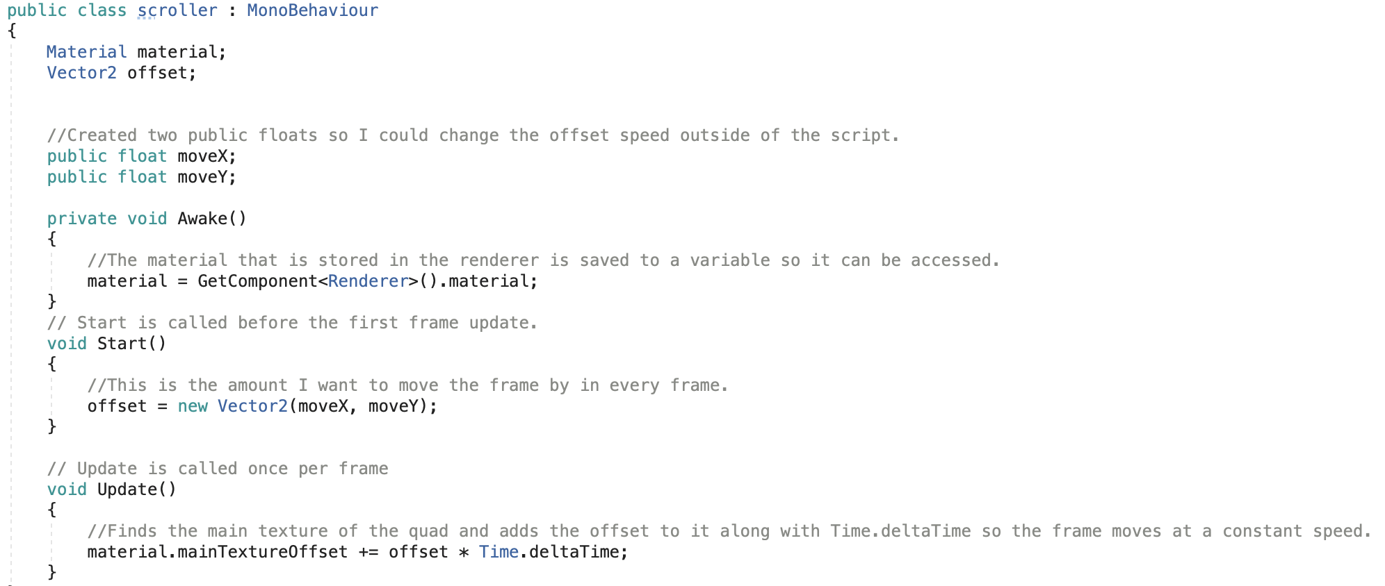
Parallaxing Background
To create a parallaxing background I used two quads and changed the offset of the quads at different speeds. The sand quad is slower than the sea quad.

Slide 6
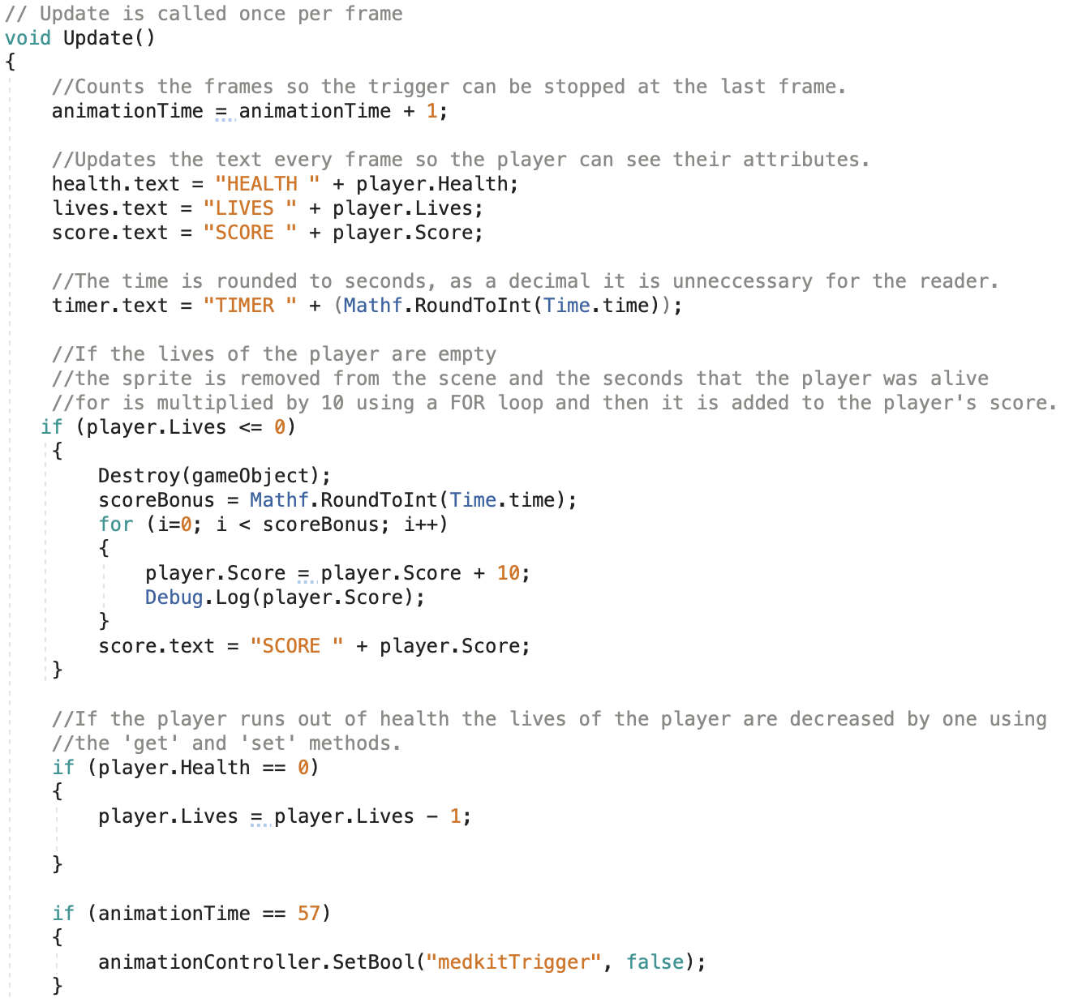
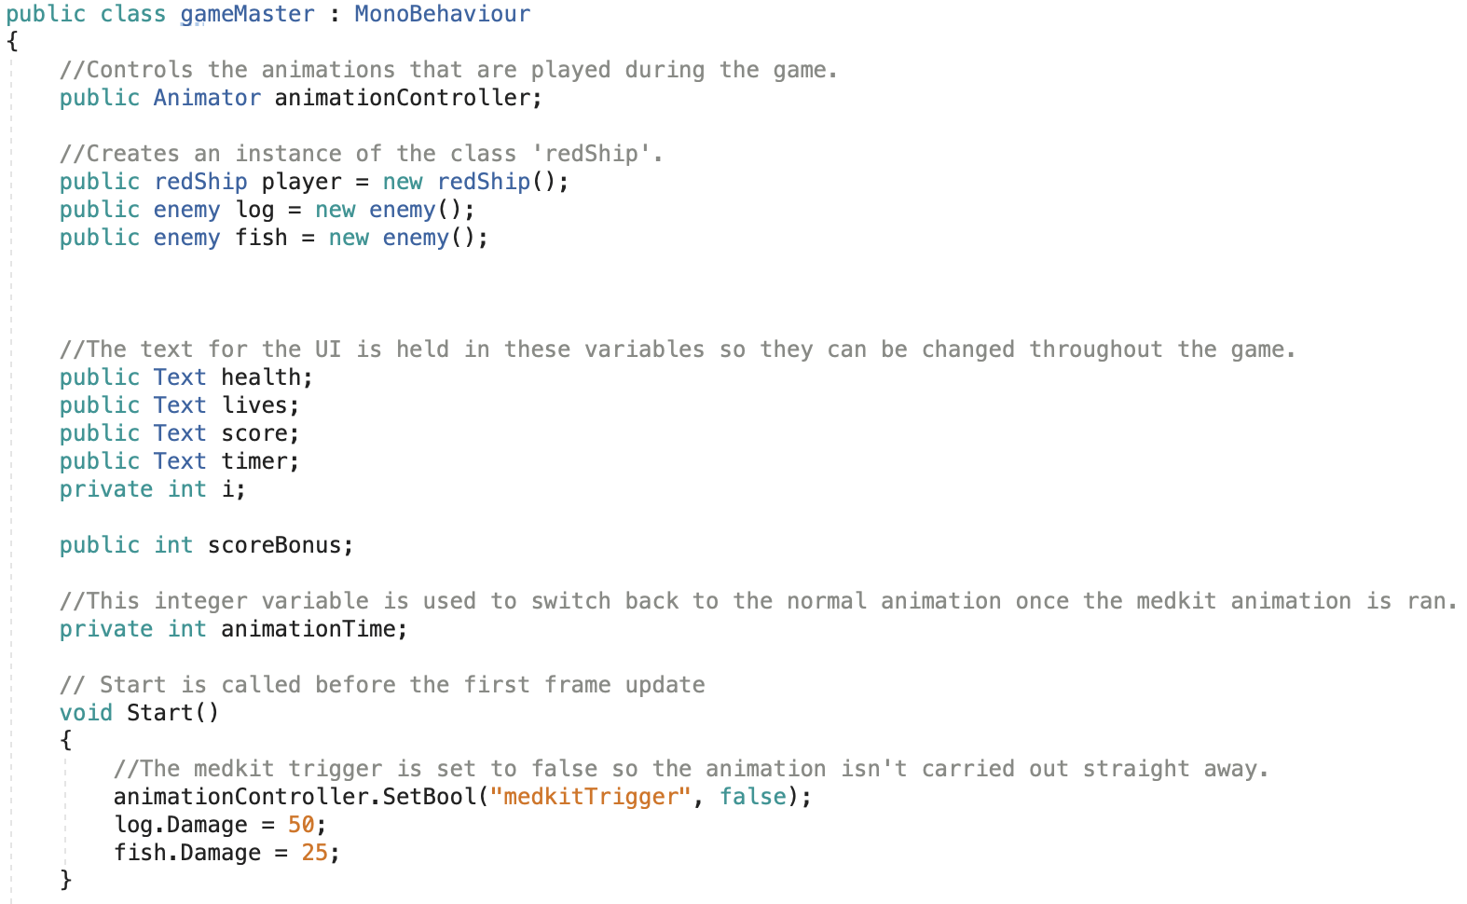
Game Master

Slide 7
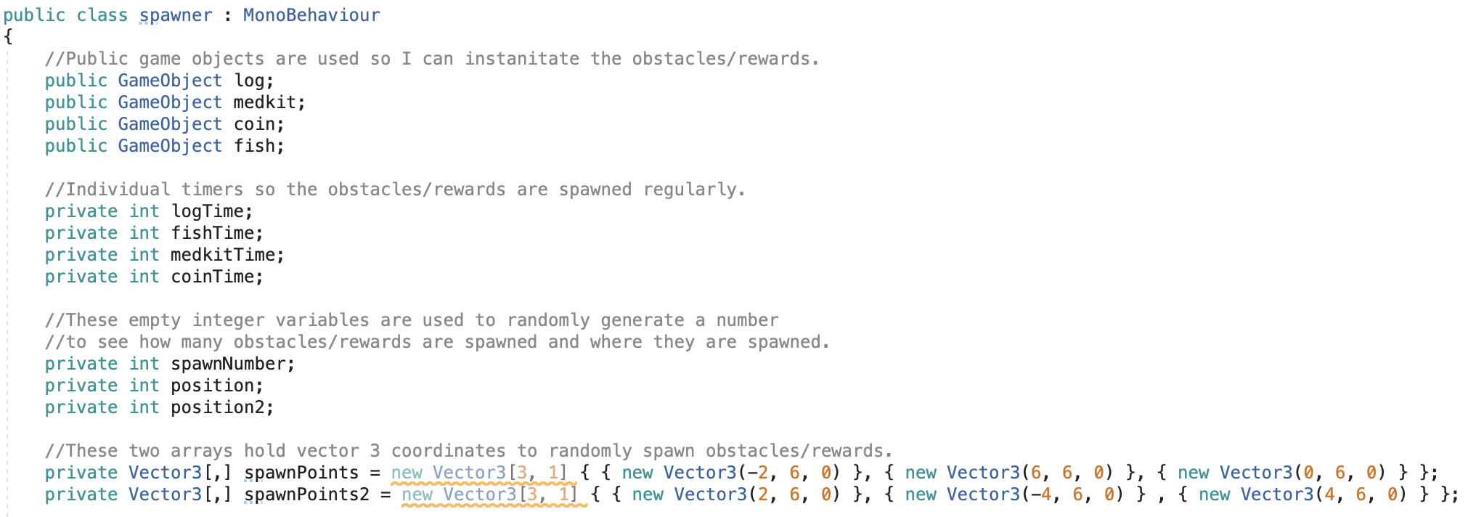
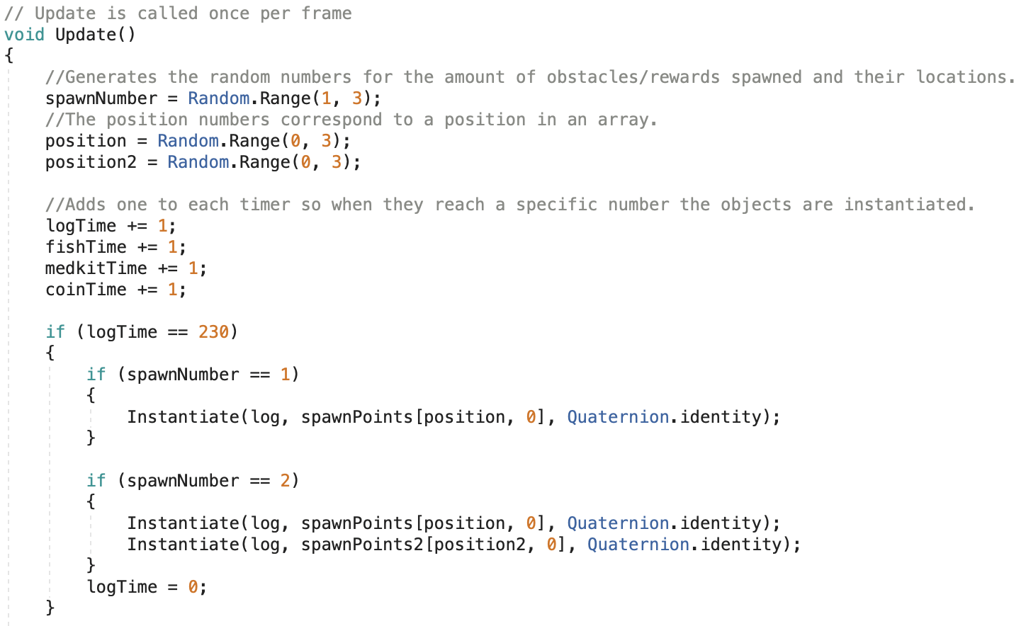
Spawner

Slide 8
Weather Conditions

Slide 9
Water Based Animations

Slide 10
Two Player Implementation

Slide 11
Opponent Sabotage Mechanic

Slide 12
Data Structures

Slide 13
Properties

Slide 14
Methods

Slide 15
Encapsulation

Slide 16
Inheritance
The cannon ball class inherits the enemy class to obtain the damage properties and the ‘applyDamage’ method.

Slide 17
Polymorphism
The cannon ball class overrides the ’applyDamage’ class to add a multiply the damage statistics by 2.
The cannon ball class has an extra method called ‘applyScore’ to subtract score from the opponent. A for loop is used to calculate the amount to subtract from the opponents score.
There is also an added property in the cannon ball class for the score damage to the opponent.

Slide 18
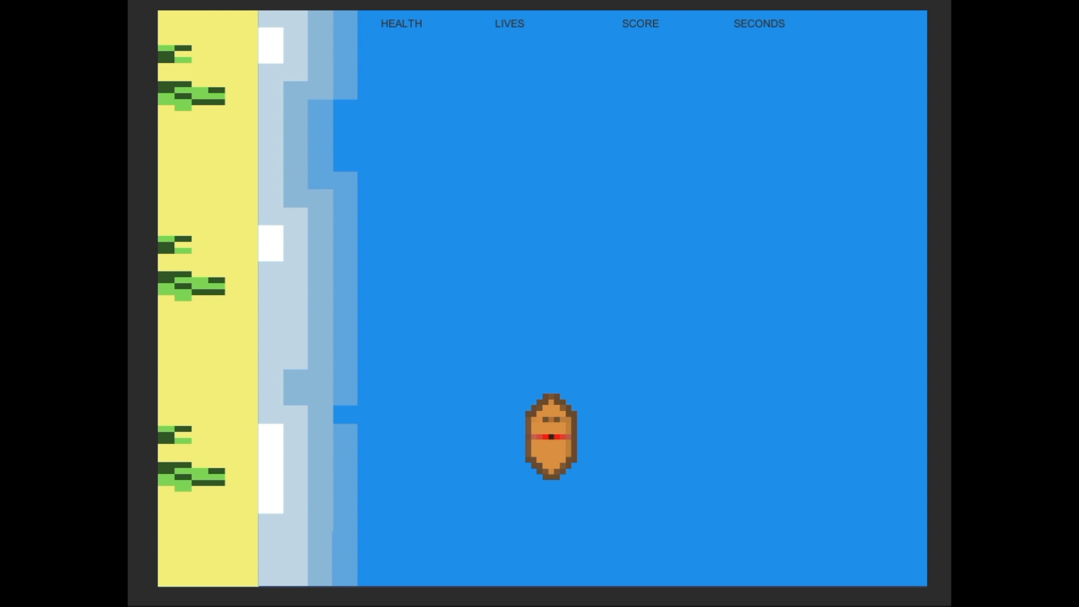
Video

Slide 19
References
Creating a Continuous Scrolling Background: https://www.youtube.com/watch?v=epRPKFsOPck
Xbox Controller Inputs: https://www.bing.com/videos/search?q=xbox+controller+input+unity&view=detail&mid=461D1E7EAD29C617DA98461D1E7EAD29C617DA98&FORM=VIRE
Animation Switching: https://www.youtube.com/watch?v=HVCsg_62xYw

